Slide 1
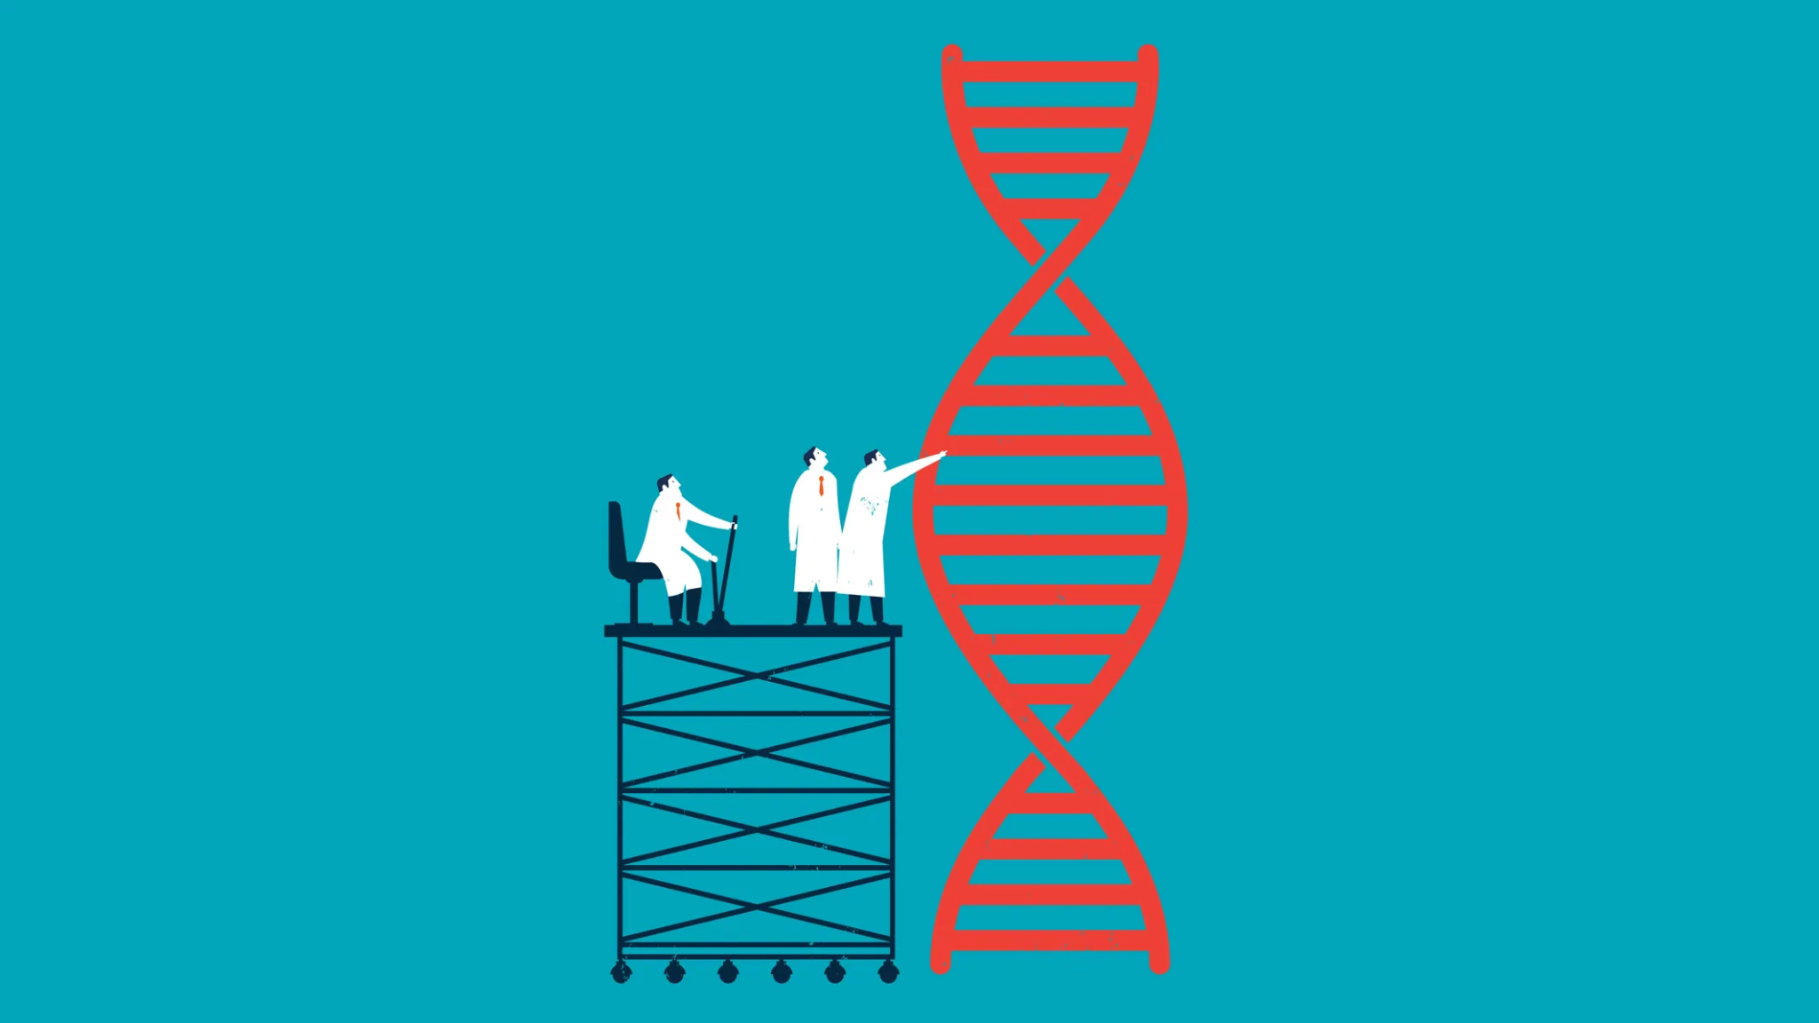
Exploring the 3D Organization of Genome
Problem Statement: To identify the regions governing gene regulation and classify them as diseased and non- diseased.
Shreya Pawaskar - 4947
Radhika Sethi - 4456
Aanchal Tulsiani - 4964
Internal Guide: Mrs. Pranjali Deshpande
External Guide: Dr. Leelavati Narlikar
Mentor: Miss. Anushua Biswas

Slide 2
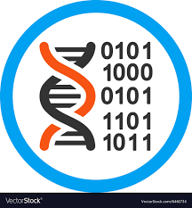
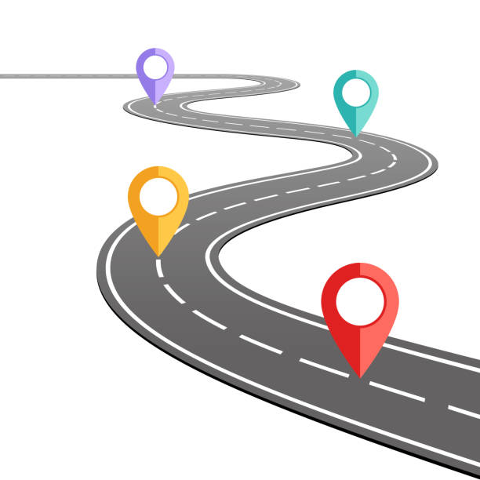
Road Map
Introduction
Literature Review
Motivation
Formation of Problem Statement
Proposed Methodology
Requirements
Notes:
Intro-probolem stm - motivation -

Slide 3
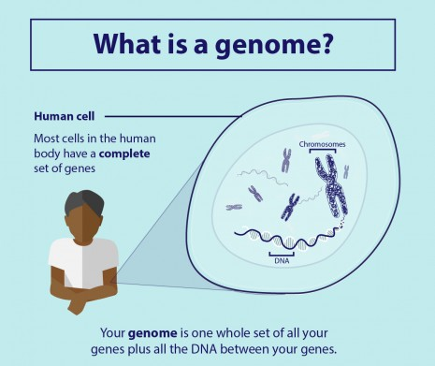
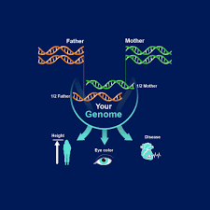
Introduction
Genomes:
DNA is the hereditary material in all living cells
Sum total of an organism's DNA.
Complete set of genetic information in an organism
Provides all of the information the organism requires to function
The study and analysis of genomes is called genomics.

Slide 4
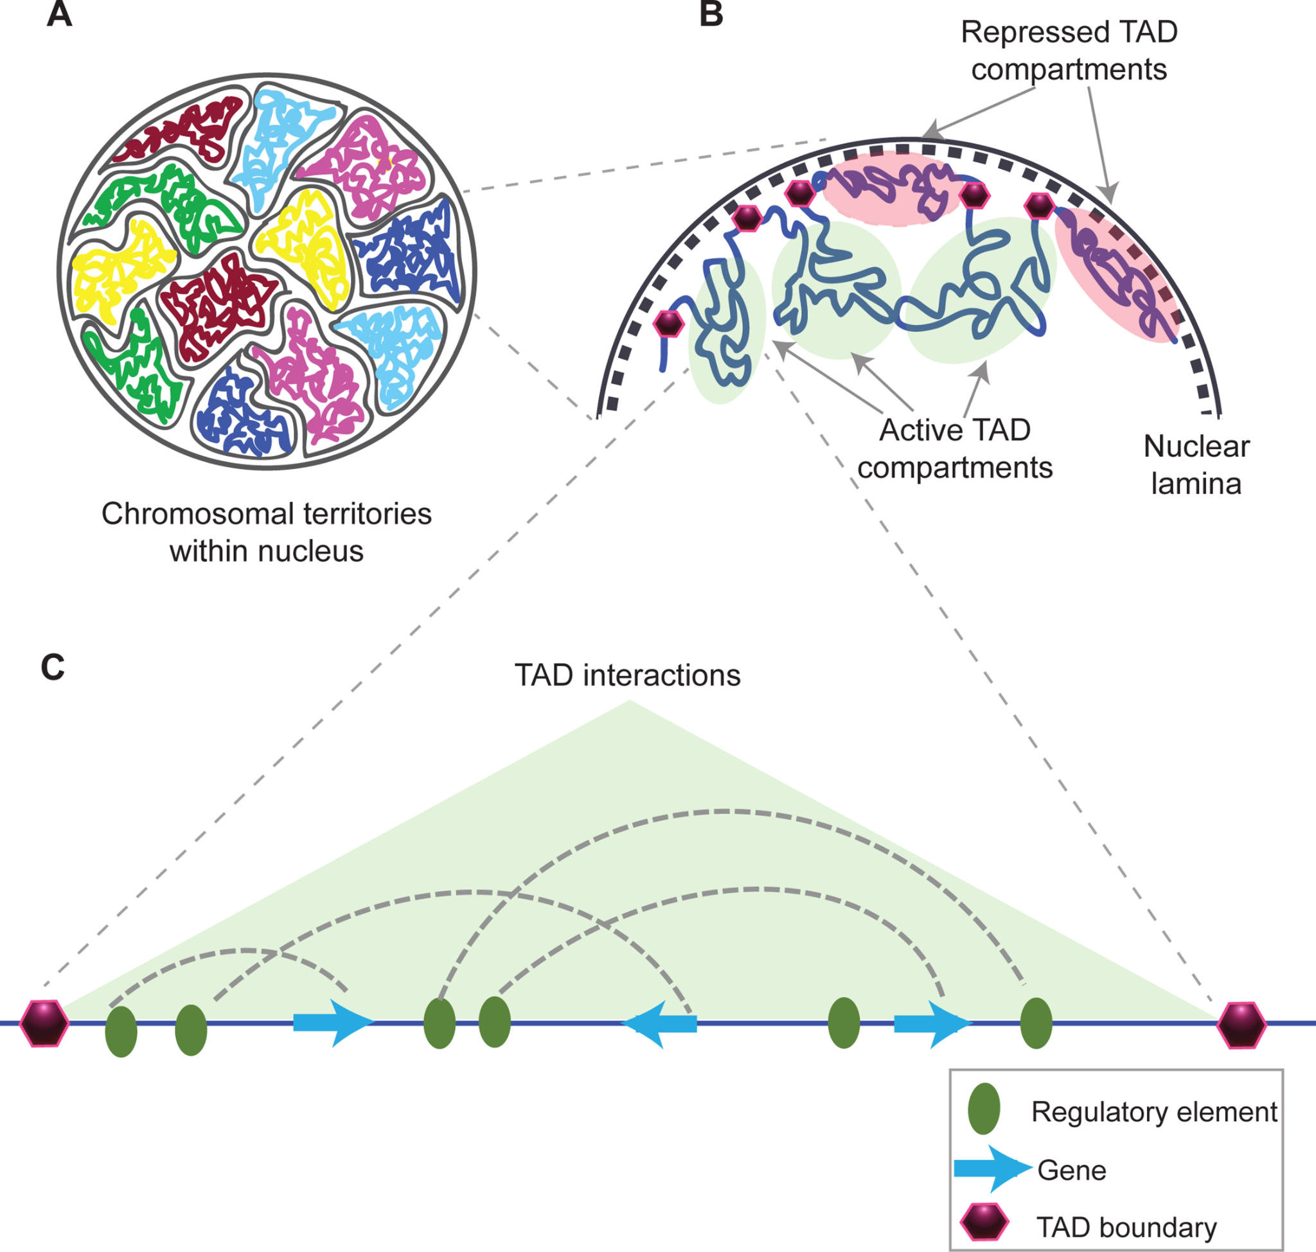
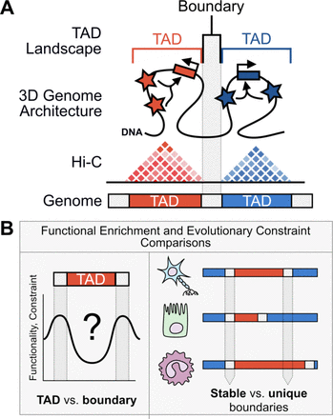
Topologically associating domains (TADs):
Extremely interacting regions of the genomes
In charge of a collection of genes
Self-interacting domains found in the 3D genome organization
2800 and 3741 TADs in primary human blood cell types.
TAD disruption can result in altered gene expression - cancer / genetic diseases
Notes:
TAD disruption can result in altered gene expression, linked to genetic diseases and cancer.
In a diseased cell, these regions may shift, resulting in the activation of different genes and the synthesis of incorrect proteins

Slide 5
Literature Review
Paper Name | Author Names | Year | Details
Methods for mapping 3D chromosome architecture | Rieke Kempfer & Ana Pombo | 2019 | Discusses the Chromatin Conformation Capture 3C approach needed to study the chromatin structure. They reveal the chromosome organization.
3C and 3C-based techniques: the powerful tools for spatial genome organization deciphering | Jinlei Han, Zhiliang Zhang & Kai Wang | 2018 | Discusses how Hi-C has helped in visualizing the abstract 3D structure of the genome. High-throughput and long sequencing reads, single cell sequencing and epigenomics data provide us more insights on the 3D genome .
Comparative Hi-C Reveals that CTCF Underlies Evolution of Chromosomal Domain Architecture | Matteo Vietri Rudan,Christopher Barrington,Stephen Henderson,Christina Ernst, Duncan T.Odom, Amos Tanay,Suzana Hadjur | 2015 | Tells us how Hi-C is used to detect gene proximity and chromosomal rearrangements. Hi-C approach extends 3C-Seq to map chromatin contacts genome-wide, and it has also been applied to studying in situ chromatin interactions.
A decade of 3C technologies: insights into nuclear organization | Elzo de Wit and Wouter de Laat | 2012 | Discusses how current 3C, 4C [ chromosome conformation capture-on-chip ], 5C [chromosome conformation capture carbon copy], HiC, and ChIA-PET),have contributed to our current understanding of genome structure

Slide 6
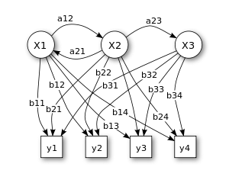
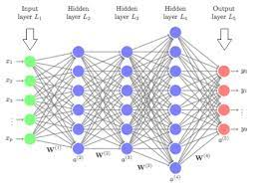
Literature Review
Method | Description | Advantages | Disadvantages
3C | Used to study chromatin structure Basis for several derivative techniques | Highly Quantitative Easy Data Analysis | Large amount of input cells
4C | A derivative 3C method Designed to search the genome for sequences contacting a selected genomic site of interest | Modified and better protocol than 3C | Chromatin interactions must be close and stable to be detected
5C | Known as 3C-Carbon Copy. Detects interactions between all restriction fragments within a given region | High efficiency | Cannot detect contact larger than a few MBs
Hi-C | Capable of identifying long range interactions Used to analyze genome-wide chromatin organization | Interactions can be detected even over relatively large genomic-distances Can detect in-cis interactions and trans-interactions | Low resolution Deep sequencing needed
Statistical Techniques | Used in statistical analysis of raw research data. Provides different ways to assess the robustness of research outputs. | Flexibility - Fits data Better Can handle inputs of variable lengths | High memory and compute time
Deep Learning | Class of machine learning algorithms Create models with several hidden layers of neural networks to make accurate predictions. | Efficient at Delivering High-quality Results Best Results with Unstructured Data No Need for Feature Engineering | Requires very large amount of data Extremely expensive to train due to complex data models

Slide 7
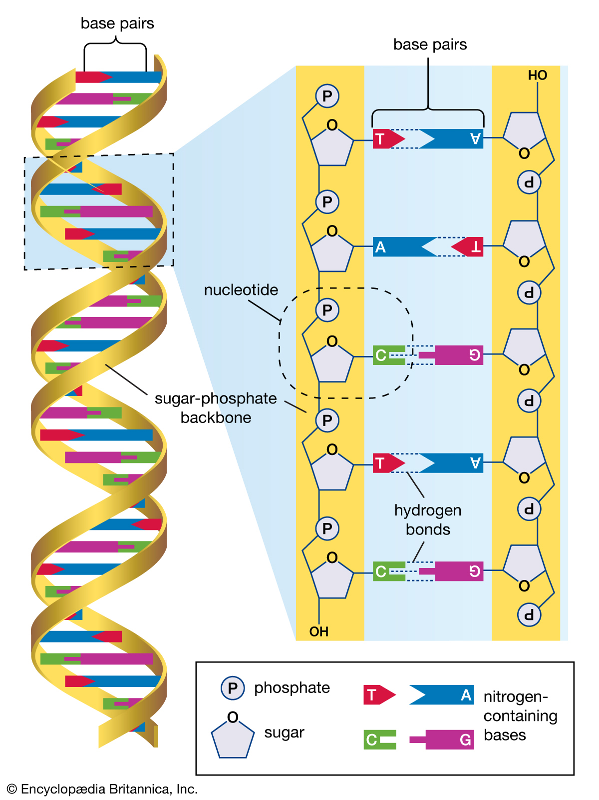
Motivation
Genes account for only 2% of the genomes
Majority of the Diseases and disorders are caused by incorrect gene expression.
All chronic diseases are believed to be caused by mis regulation of genes.
We can describe how the non-coding portion of our DNA by investigating the transcription factors.
So there is a need to explore genomic sequences at TAD boundaries.
Existing Solutions from the Problem:
3C-based methods
4C [chromosome conformation capture-on-chip]
5C [chromosome conformation capture carbon copy]
HiC
Notes:
When we look at the entire human genome, we see that genes (functional elements) account for only about 2% of the genome.
Diseases and disorders caused by gene level issues are also taken into account. So the rest of the wide range of diseases and their variations (for example, diabetes can affect someone severely while remaining mild in others) are mostly caused by non-gene mutations.
One way we can describe how the non-coding portion of our DNA is by investigating the transcription factors that bind there.
Which is why we want to explore genomic sequences at TAD boundaries.

Slide 8
Formation of Problem Statement
Thus, our Problem Statement is as follows:
“To identify the regions governing gene regulation and classify them as diseased and non- diseased.”
The Objectives being covered are :
Learn how to model biological sequencing and DNA data. Understand their underlying properties and how to find patterns in them
Efficiently use deep learning algorithms to distinguish TADs and their boundaries.
Classify genomic sequences as potentially interacting regions or non-interacting regions
Find which traits of TADs in these regions make them more interactive.
Understand how these specific regions influence gene regulation.
Find genomic sequence properties which influence the transformation of a cell into a diseased cell.

Slide 9
Proposed Methodology
INPUT
CLASSIFICATION
EXPLAINABLE AI
Model: Classification into diseased or non-diseased cell
Understanding the classification output, explore WHAT caused the classification
Hi-C Experimental Data

Slide 10
Flow Diagram
Data Preprocessing
Classification
Explainable AI
- Input data: Hi-C experimental data (<1MB)
BED File (browser extensible data) with 20k regions of the human genome
- Convert data to a fasta format (text data ATGC)
- Bioinformatics pipelines
- Higher Order Markov Models
- Using data as an image data for Convolution Neural Networks: DeepBind
- Since deep learning models are hard to interpret: DeepLift for the Explainable AI to backtrack and answer “WHY”

Slide 11



Requirements
Technical Requirements:
Google Colab
BED Tools
DeepLift - Stanford Lab
DeepBind - University of Toronto Lab
Hardware required:
GPU access for training models
Linux Kernel for bioinformatics tools (BED Tools)
Intel i3 or higher
4GB RAM
1 Gb hard free drive space

Slide 12
References
Methods for mapping 3D chromosome architecture: theory https://www.nature.com/articles/s41576-019-0195-2
3C and 3C-based techniques: the powerful tools for spatial genome organization deciphering: method https://molecularcytogenetics.biomedcentral.com/articles/10.1186/s13039-018-0368-2
A decade of 3C technologies: insights into nuclear organization: theory http://genesdev.cshlp.org/content/26/1/11.full
Comparative Hi-C Reveals that CTCF Underlies Evolution of Chromosomal Domain Architecture: method https://www.sciencedirect.com/science/article/pii/S2211124715001126#app1

Slide 13
Thank you

